Slide 1
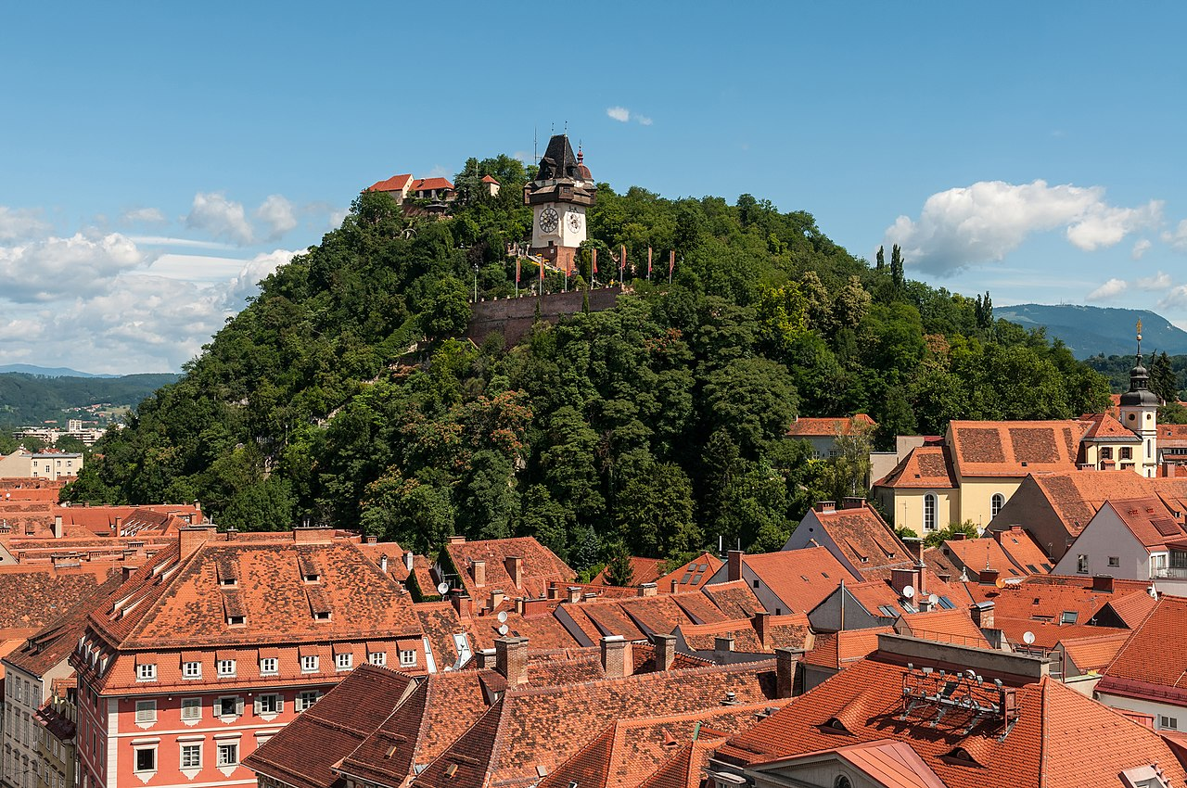
The Tourist
Graz as seen by Grazers as experienced by a platformer hero

Slide 2
Surviving Graz
It is something we do every day
We demonstrate the challenges that this entails
You are a tourist
Find your way to the city’s many destinations!
Battle annoying hipsters, evil BWL students, and more!
Choose your outfit to take the perfect selfie!
Notes:
Our game is all about the struggle of surviving a day in Graz. We may take it for granted, since we do it every day, but our game puts you into the shoes of a tourist, visiting the city for the first time. The challenges of the city, such as hipsters, BWL students, and more are all that stand between you and your goal of seeing the city’s attractions, while customizing the look of your character.

Slide 3


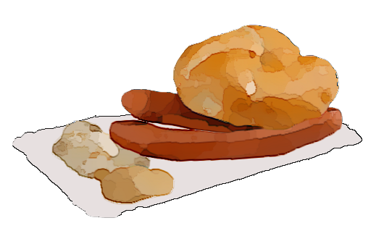
Your Goal
Jump and run through unique levels
Interact with objects in your environment
Use trashcans and theater seats to overcome obstacles
Eat “Döner”, drink “Geidorfer” ^{(not trademarked)} beer, and have “Frankfurter mit Semmel” to power up your hero
Collect selfies at all of the tourist destinations
Notes:
Your goal, as a tourist, is to collect selfies at the city’s top destinations, obviously. The levels begin at the tram station and all end at a unique attraction. Throughout the level you need to use the environment to overcome puzzles and platforming challenges, while powering up your hero with Grazer treats such as Döners, Geidorfer beer, and Frankfurters with a Semmel.

Slide 4
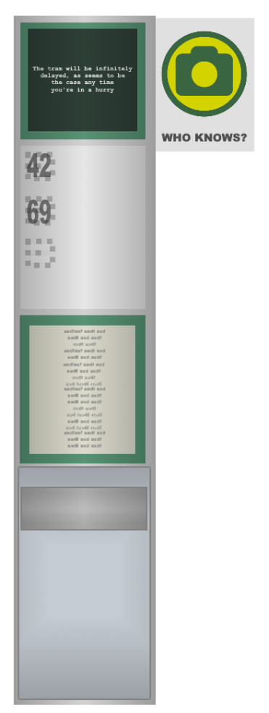
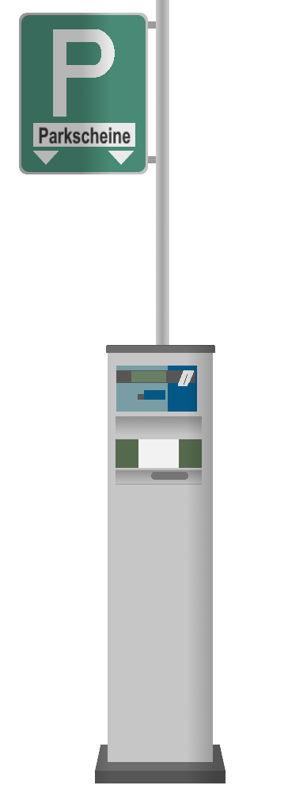




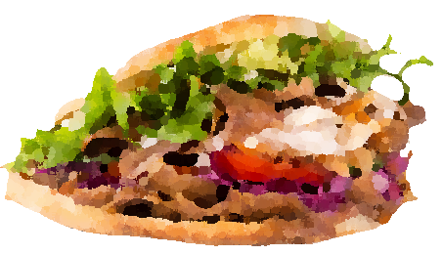

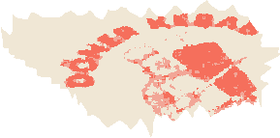
Game Overview
The current version of the game has 6 fully playable levels Take selfies at the:
Historic opera
Modern art museum
Iconic clock tower
…and more
Enjoy dozens of hand-crafted sprites that highlight the Graz we take for granted

Slide 5
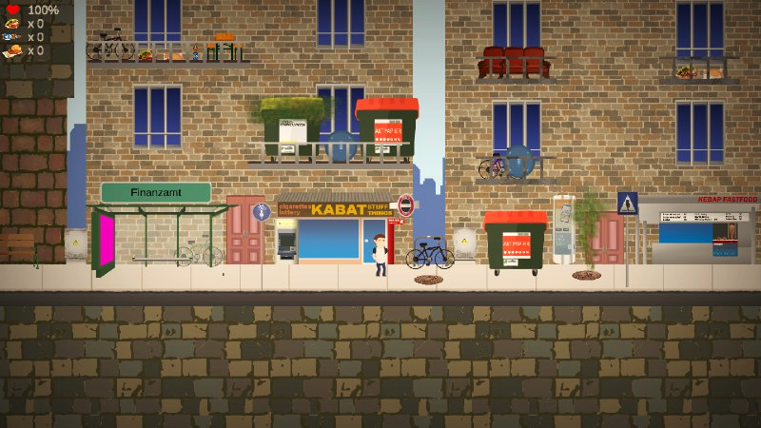
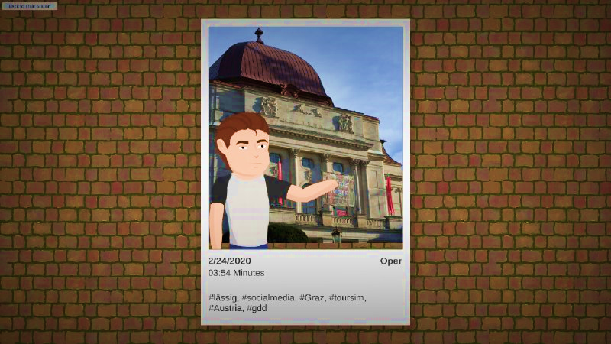
Gameplay Overview
Keep track of your health and your collected upgrades at a glance.
Move throughout the levels Interact with the objects in the world to navigate to the end Your reward: a personalized selfie in front of your goal!

Slide 6
Gameplay Demo
Video

Slide 7
Thank you for your attention
Image credit: Wikimedia Austria
Music: https://www.bensound.com

